Slide 1

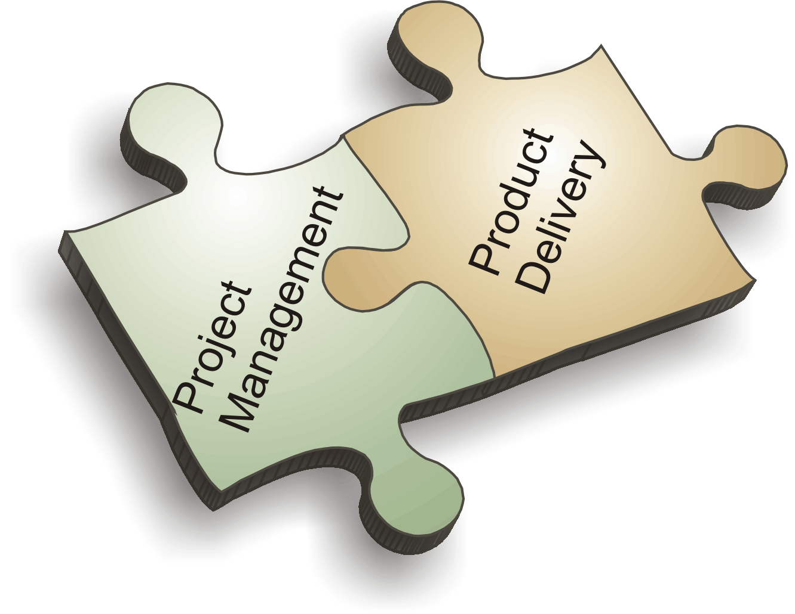
PROJECT MANAGEMENT
UNIT- IV

Slide 2
Risk & Uncertainty
PROJECT MANAGEMENT
Notes:
A project is a unique endeavor to produce a set of deliverables within clearly specified time, cost and quality constraints. Projects are different from standard business operational activities as they:
• Are unique in nature. They do not involve repetitive processes. Every project undertaken is different from the last, whereas operational activities often involve undertaking repetitive (identical) processes.
• Have a defined timescale. Projects have a clearly specified start and end date within which the deliverables must be produced to meet a specified customer requirement.
• Have an approved budget. Projects are allocated a level of financial expenditure within which the deliverables are produced, to meet a specified customer requirement.
• Have limited resources. At the start of a project an agreed amount of labor, equipment and materials is allocated to the project.
• Involve an element of risk. Projects entail a level of uncertainty and therefore carry business risk.
• Achieve beneficial change. The purpose of a project is typically to improve an organization through the implementation of business change.

Slide 3

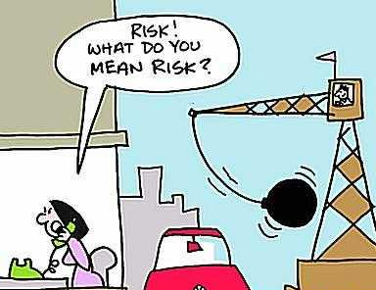
Risk
Risk is the possibility of outcome being different form the expected outcome.
If the probabilities of possible outcome of a given problem are known, we can conclude that the problem contains Risk, i.e. the problem is risky.
PROJECT MANAGEMENT
Notes:
A project is a unique endeavor to produce a set of deliverables within clearly specified time, cost and quality constraints. Projects are different from standard business operational activities as they:
• Are unique in nature. They do not involve repetitive processes. Every project undertaken is different from the last, whereas operational activities often involve undertaking repetitive (identical) processes.
• Have a defined timescale. Projects have a clearly specified start and end date within which the deliverables must be produced to meet a specified customer requirement.
• Have an approved budget. Projects are allocated a level of financial expenditure within which the deliverables are produced, to meet a specified customer requirement.
• Have limited resources. At the start of a project an agreed amount of labor, equipment and materials is allocated to the project.
• Involve an element of risk. Projects entail a level of uncertainty and therefore carry business risk.
• Achieve beneficial change. The purpose of a project is typically to improve an organization through the implementation of business change.

Slide 4
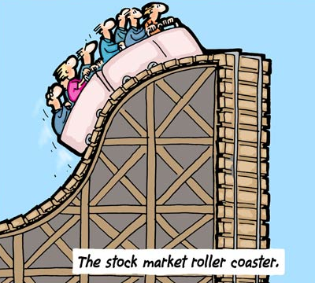
Uncertainty
If the probabilities of possible outcome of a given problem are not known, we can conclude that the problem has an element of uncertainty, i.e. the outcome can not be predicted.
PROJECT MANAGEMENT
Notes:
A project is a unique endeavor to produce a set of deliverables within clearly specified time, cost and quality constraints. Projects are different from standard business operational activities as they:
• Are unique in nature. They do not involve repetitive processes. Every project undertaken is different from the last, whereas operational activities often involve undertaking repetitive (identical) processes.
• Have a defined timescale. Projects have a clearly specified start and end date within which the deliverables must be produced to meet a specified customer requirement.
• Have an approved budget. Projects are allocated a level of financial expenditure within which the deliverables are produced, to meet a specified customer requirement.
• Have limited resources. At the start of a project an agreed amount of labor, equipment and materials is allocated to the project.
• Involve an element of risk. Projects entail a level of uncertainty and therefore carry business risk.
• Achieve beneficial change. The purpose of a project is typically to improve an organization through the implementation of business change.

Slide 5
Types of Risk
Completion Risk (if the project seems not to be completed in time)
Technical Risk (if it seems failure to meet a particular performance)
Social Risk (seems to have social cost / against customers or society)
Economic Risk (increase in inflation, policies, income level etc.)
Political Risk (political instability, change in policy, trade restriction)
Production Risk (shortage in inputs, increase in costs)
Marketing Risk (failure of product in satisfying the demand)
Financial Risk (bad debts, change in interest rate, wrong investment)
PROJECT MANAGEMENT
Notes:
A project is a unique endeavor to produce a set of deliverables within clearly specified time, cost and quality constraints. Projects are different from standard business operational activities as they:
• Are unique in nature. They do not involve repetitive processes. Every project undertaken is different from the last, whereas operational activities often involve undertaking repetitive (identical) processes.
• Have a defined timescale. Projects have a clearly specified start and end date within which the deliverables must be produced to meet a specified customer requirement.
• Have an approved budget. Projects are allocated a level of financial expenditure within which the deliverables are produced, to meet a specified customer requirement.
• Have limited resources. At the start of a project an agreed amount of labor, equipment and materials is allocated to the project.
• Involve an element of risk. Projects entail a level of uncertainty and therefore carry business risk.
• Achieve beneficial change. The purpose of a project is typically to improve an organization through the implementation of business change.

Slide 6
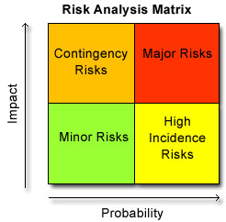
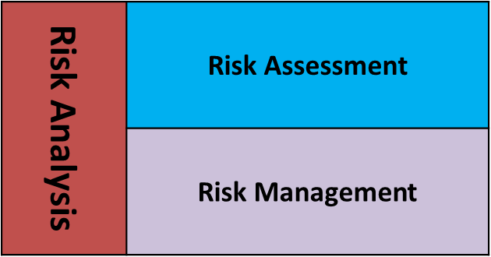
Risk Analysis
A process of identifying and quantifying the risk involved in a project and developing measures to avoid and manage such risk.
Risk analysis can be classified in two heads:
PROJECT MANAGEMENT
Notes:
A project is a unique endeavor to produce a set of deliverables within clearly specified time, cost and quality constraints. Projects are different from standard business operational activities as they:
• Are unique in nature. They do not involve repetitive processes. Every project undertaken is different from the last, whereas operational activities often involve undertaking repetitive (identical) processes.
• Have a defined timescale. Projects have a clearly specified start and end date within which the deliverables must be produced to meet a specified customer requirement.
• Have an approved budget. Projects are allocated a level of financial expenditure within which the deliverables are produced, to meet a specified customer requirement.
• Have limited resources. At the start of a project an agreed amount of labor, equipment and materials is allocated to the project.
• Involve an element of risk. Projects entail a level of uncertainty and therefore carry business risk.
• Achieve beneficial change. The purpose of a project is typically to improve an organization through the implementation of business change.

Slide 7
Risk Assessment
A process of identifying and quantifying the risk.
To find out the reasons / sources of risk
To know the probability of occurring of risk.
PROJECT MANAGEMENT
Notes:
A project is a unique endeavor to produce a set of deliverables within clearly specified time, cost and quality constraints. Projects are different from standard business operational activities as they:
• Are unique in nature. They do not involve repetitive processes. Every project undertaken is different from the last, whereas operational activities often involve undertaking repetitive (identical) processes.
• Have a defined timescale. Projects have a clearly specified start and end date within which the deliverables must be produced to meet a specified customer requirement.
• Have an approved budget. Projects are allocated a level of financial expenditure within which the deliverables are produced, to meet a specified customer requirement.
• Have limited resources. At the start of a project an agreed amount of labor, equipment and materials is allocated to the project.
• Involve an element of risk. Projects entail a level of uncertainty and therefore carry business risk.
• Achieve beneficial change. The purpose of a project is typically to improve an organization through the implementation of business change.

Slide 8
Risk Management
The process of avoiding or minimizing the impact of assessed risk. Risk management at the time of project evaluation may be done as:
At the time of Project Evaluation
At the time of Project Implementation
PROJECT MANAGEMENT
Notes:
A project is a unique endeavor to produce a set of deliverables within clearly specified time, cost and quality constraints. Projects are different from standard business operational activities as they:
• Are unique in nature. They do not involve repetitive processes. Every project undertaken is different from the last, whereas operational activities often involve undertaking repetitive (identical) processes.
• Have a defined timescale. Projects have a clearly specified start and end date within which the deliverables must be produced to meet a specified customer requirement.
• Have an approved budget. Projects are allocated a level of financial expenditure within which the deliverables are produced, to meet a specified customer requirement.
• Have limited resources. At the start of a project an agreed amount of labor, equipment and materials is allocated to the project.
• Involve an element of risk. Projects entail a level of uncertainty and therefore carry business risk.
• Achieve beneficial change. The purpose of a project is typically to improve an organization through the implementation of business change.

Slide 9
Risk Management
At the time of Project Evaluation
Judgmental Evaluation
(without using any formal method, accepting/rejecting project)
Pay Back Period Requirement
(Risk is a function of time, use of PBP along with NPV or IRR risk)
Risk Adjusted Discount Rate
(r = i + d; r = risk adjusted discount rate, I = normal discount rate, d = risk factor )
Collecting more and more information
(by updating self)
PROJECT MANAGEMENT
Notes:
A project is a unique endeavor to produce a set of deliverables within clearly specified time, cost and quality constraints. Projects are different from standard business operational activities as they:
• Are unique in nature. They do not involve repetitive processes. Every project undertaken is different from the last, whereas operational activities often involve undertaking repetitive (identical) processes.
• Have a defined timescale. Projects have a clearly specified start and end date within which the deliverables must be produced to meet a specified customer requirement.
• Have an approved budget. Projects are allocated a level of financial expenditure within which the deliverables are produced, to meet a specified customer requirement.
• Have limited resources. At the start of a project an agreed amount of labor, equipment and materials is allocated to the project.
• Involve an element of risk. Projects entail a level of uncertainty and therefore carry business risk.
• Achieve beneficial change. The purpose of a project is typically to improve an organization through the implementation of business change.

Slide 10
Risk Management
At the time of Project Implementation
Converting Fixed cost to Variable Cost
Sequential Investment
(start with small and later expand)
Reduced Financial Leverage (Using less debt capital)
(r = i + d; r = risk adjusted discount rate, I = normal discount rate, d = risk factor )
Insurance
Long Term Arrangements
Strategic Alliance
PROJECT MANAGEMENT
Notes:
A project is a unique endeavor to produce a set of deliverables within clearly specified time, cost and quality constraints. Projects are different from standard business operational activities as they:
• Are unique in nature. They do not involve repetitive processes. Every project undertaken is different from the last, whereas operational activities often involve undertaking repetitive (identical) processes.
• Have a defined timescale. Projects have a clearly specified start and end date within which the deliverables must be produced to meet a specified customer requirement.
• Have an approved budget. Projects are allocated a level of financial expenditure within which the deliverables are produced, to meet a specified customer requirement.
• Have limited resources. At the start of a project an agreed amount of labor, equipment and materials is allocated to the project.
• Involve an element of risk. Projects entail a level of uncertainty and therefore carry business risk.
• Achieve beneficial change. The purpose of a project is typically to improve an organization through the implementation of business change.

Slide 11
COST of Projects
PROJECT MANAGEMENT
Notes:
A project is a unique endeavor to produce a set of deliverables within clearly specified time, cost and quality constraints. Projects are different from standard business operational activities as they:
• Are unique in nature. They do not involve repetitive processes. Every project undertaken is different from the last, whereas operational activities often involve undertaking repetitive (identical) processes.
• Have a defined timescale. Projects have a clearly specified start and end date within which the deliverables must be produced to meet a specified customer requirement.
• Have an approved budget. Projects are allocated a level of financial expenditure within which the deliverables are produced, to meet a specified customer requirement.
• Have limited resources. At the start of a project an agreed amount of labor, equipment and materials is allocated to the project.
• Involve an element of risk. Projects entail a level of uncertainty and therefore carry business risk.
• Achieve beneficial change. The purpose of a project is typically to improve an organization through the implementation of business change.

Slide 12
Cost of Project
Direct: Direct costs are expenses that come out of the project budget directly. For example, if you have outsourced some of your development work, the developers are expected to put in a specific amount of time, which is then billed for. The developer salaries are direct costs.
Indirect: Indirect costs are those that are shared across multiple projects. Indirect costs are sometimes also referred to as Oversight costs. For example, in software development projects, it is common for a project manager or an architect to be partially allocated across several projects. Hence, the cost of the project manager or architect will be shared among the projects they are allocated to.
Project managers are usually an indirect cost to the project. This is because their work is to supervise.
PROJECT MANAGEMENT
Notes:
A project is a unique endeavor to produce a set of deliverables within clearly specified time, cost and quality constraints. Projects are different from standard business operational activities as they:
• Are unique in nature. They do not involve repetitive processes. Every project undertaken is different from the last, whereas operational activities often involve undertaking repetitive (identical) processes.
• Have a defined timescale. Projects have a clearly specified start and end date within which the deliverables must be produced to meet a specified customer requirement.
• Have an approved budget. Projects are allocated a level of financial expenditure within which the deliverables are produced, to meet a specified customer requirement.
• Have limited resources. At the start of a project an agreed amount of labor, equipment and materials is allocated to the project.
• Involve an element of risk. Projects entail a level of uncertainty and therefore carry business risk.
• Achieve beneficial change. The purpose of a project is typically to improve an organization through the implementation of business change.

Slide 13
Cost of Project
Non-Recurring: non-recurring cost. Unusual charge, expense, or loss that is unlikely to occur again in the normal course of a business. Non recurring costs include write offs such as design, development, and investment costs, and fire or theft losses, lawsuit payments, losses on sale of assets, and moving expenses.
Fixed: Fixed costs are those that do not change throughout the life-cycle of a project.
Variable: as the name suggests, are costs that change during the project life-cycle. Construction projects usually have a long duration and can easily span several years.
PROJECT MANAGEMENT
Notes:
A project is a unique endeavor to produce a set of deliverables within clearly specified time, cost and quality constraints. Projects are different from standard business operational activities as they:
• Are unique in nature. They do not involve repetitive processes. Every project undertaken is different from the last, whereas operational activities often involve undertaking repetitive (identical) processes.
• Have a defined timescale. Projects have a clearly specified start and end date within which the deliverables must be produced to meet a specified customer requirement.
• Have an approved budget. Projects are allocated a level of financial expenditure within which the deliverables are produced, to meet a specified customer requirement.
• Have limited resources. At the start of a project an agreed amount of labor, equipment and materials is allocated to the project.
• Involve an element of risk. Projects entail a level of uncertainty and therefore carry business risk.
• Achieve beneficial change. The purpose of a project is typically to improve an organization through the implementation of business change.

Slide 14
Cost of Project
Normal: Normal cost is the lowest possible direct cost required to complete an activity.
Expedite costs: These are costs are routine costs associated with completing the scheduled work agreed upon by the stakeholders at the start of the project.
Sunk Costs: Sunk costs are those that have been incurred in a project, but have not produced value towards the project’s objectives. For example, if you are making a cup of tea and spill the milk that was to be used in the tea, then the value of the milk is your sunk costs.
PROJECT MANAGEMENT
Notes:
A project is a unique endeavor to produce a set of deliverables within clearly specified time, cost and quality constraints. Projects are different from standard business operational activities as they:
• Are unique in nature. They do not involve repetitive processes. Every project undertaken is different from the last, whereas operational activities often involve undertaking repetitive (identical) processes.
• Have a defined timescale. Projects have a clearly specified start and end date within which the deliverables must be produced to meet a specified customer requirement.
• Have an approved budget. Projects are allocated a level of financial expenditure within which the deliverables are produced, to meet a specified customer requirement.
• Have limited resources. At the start of a project an agreed amount of labor, equipment and materials is allocated to the project.
• Involve an element of risk. Projects entail a level of uncertainty and therefore carry business risk.
• Achieve beneficial change. The purpose of a project is typically to improve an organization through the implementation of business change.

Slide 15
Project Budgeting
PROJECT MANAGEMENT
Notes:
A project is a unique endeavor to produce a set of deliverables within clearly specified time, cost and quality constraints. Projects are different from standard business operational activities as they:
• Are unique in nature. They do not involve repetitive processes. Every project undertaken is different from the last, whereas operational activities often involve undertaking repetitive (identical) processes.
• Have a defined timescale. Projects have a clearly specified start and end date within which the deliverables must be produced to meet a specified customer requirement.
• Have an approved budget. Projects are allocated a level of financial expenditure within which the deliverables are produced, to meet a specified customer requirement.
• Have limited resources. At the start of a project an agreed amount of labor, equipment and materials is allocated to the project.
• Involve an element of risk. Projects entail a level of uncertainty and therefore carry business risk.
• Achieve beneficial change. The purpose of a project is typically to improve an organization through the implementation of business change.

Slide 16
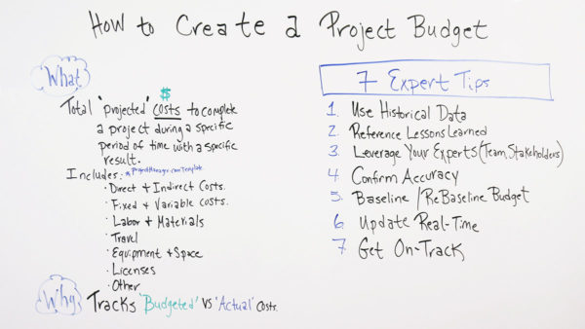
Budgeting of Project
A project budget is the total projected costs needed to complete a project over a defined period of time. It’s used to estimate what the costs of the project will be for every phase of the project.
PROJECT MANAGEMENT
Notes:
A project is a unique endeavor to produce a set of deliverables within clearly specified time, cost and quality constraints. Projects are different from standard business operational activities as they:
• Are unique in nature. They do not involve repetitive processes. Every project undertaken is different from the last, whereas operational activities often involve undertaking repetitive (identical) processes.
• Have a defined timescale. Projects have a clearly specified start and end date within which the deliverables must be produced to meet a specified customer requirement.
• Have an approved budget. Projects are allocated a level of financial expenditure within which the deliverables are produced, to meet a specified customer requirement.
• Have limited resources. At the start of a project an agreed amount of labor, equipment and materials is allocated to the project.
• Involve an element of risk. Projects entail a level of uncertainty and therefore carry business risk.
• Achieve beneficial change. The purpose of a project is typically to improve an organization through the implementation of business change.

Slide 17
Budgeting of Project
Top-down budgeting is a budgeting method in which senior management develops a high-level budget for the company. Once the top-level numbers are created, amounts are allocated to individual functions or departments that must create a detailed budget with their allocation.
Bottom up budgeting is a type of budgeting that attempts to determine the underlying costs for each individual department or segment of an organization and then total up each department.
PROJECT MANAGEMENT
Notes:
A project is a unique endeavor to produce a set of deliverables within clearly specified time, cost and quality constraints. Projects are different from standard business operational activities as they:
• Are unique in nature. They do not involve repetitive processes. Every project undertaken is different from the last, whereas operational activities often involve undertaking repetitive (identical) processes.
• Have a defined timescale. Projects have a clearly specified start and end date within which the deliverables must be produced to meet a specified customer requirement.
• Have an approved budget. Projects are allocated a level of financial expenditure within which the deliverables are produced, to meet a specified customer requirement.
• Have limited resources. At the start of a project an agreed amount of labor, equipment and materials is allocated to the project.
• Involve an element of risk. Projects entail a level of uncertainty and therefore carry business risk.
• Achieve beneficial change. The purpose of a project is typically to improve an organization through the implementation of business change.

Slide 18
Project Financing
PROJECT MANAGEMENT
Notes:
A project is a unique endeavor to produce a set of deliverables within clearly specified time, cost and quality constraints. Projects are different from standard business operational activities as they:
• Are unique in nature. They do not involve repetitive processes. Every project undertaken is different from the last, whereas operational activities often involve undertaking repetitive (identical) processes.
• Have a defined timescale. Projects have a clearly specified start and end date within which the deliverables must be produced to meet a specified customer requirement.
• Have an approved budget. Projects are allocated a level of financial expenditure within which the deliverables are produced, to meet a specified customer requirement.
• Have limited resources. At the start of a project an agreed amount of labor, equipment and materials is allocated to the project.
• Involve an element of risk. Projects entail a level of uncertainty and therefore carry business risk.
• Achieve beneficial change. The purpose of a project is typically to improve an organization through the implementation of business change.

Slide 19
Project Financing
Project financing is a loan structure that relies primarily on the project's cash flow for repayment, with the project's assets, rights, and interests held as secondary collateral. Project finance is especially attractive to the private sector because companies can fund major projects off-balance sheet.
Sources of finance:
Project finance may come from a variety of sources. The main sources include equity, debt and government grants. Financing from these alternative sources have important implications on project's overall cost, cash flow, ultimate liability and claims to project incomes and assets.
PROJECT MANAGEMENT
Notes:
A project is a unique endeavor to produce a set of deliverables within clearly specified time, cost and quality constraints. Projects are different from standard business operational activities as they:
• Are unique in nature. They do not involve repetitive processes. Every project undertaken is different from the last, whereas operational activities often involve undertaking repetitive (identical) processes.
• Have a defined timescale. Projects have a clearly specified start and end date within which the deliverables must be produced to meet a specified customer requirement.
• Have an approved budget. Projects are allocated a level of financial expenditure within which the deliverables are produced, to meet a specified customer requirement.
• Have limited resources. At the start of a project an agreed amount of labor, equipment and materials is allocated to the project.
• Involve an element of risk. Projects entail a level of uncertainty and therefore carry business risk.
• Achieve beneficial change. The purpose of a project is typically to improve an organization through the implementation of business change.

Slide 20
Project Cost Estimation
Project Cost Estimation is defined as the process of approximating the total expenditure of the project. The accuracy of the cost estimation and budgeting in project management depends on the accuracy and details of the project scope, which is the scope baseline. The scope will also define any constraints like date, resources or budget. The risk register will help to calculate estimate types of costs, the expenses made behind the contingent action and the expenses made to cope with risks.
PROJECT MANAGEMENT
Notes:
A project is a unique endeavor to produce a set of deliverables within clearly specified time, cost and quality constraints. Projects are different from standard business operational activities as they:
• Are unique in nature. They do not involve repetitive processes. Every project undertaken is different from the last, whereas operational activities often involve undertaking repetitive (identical) processes.
• Have a defined timescale. Projects have a clearly specified start and end date within which the deliverables must be produced to meet a specified customer requirement.
• Have an approved budget. Projects are allocated a level of financial expenditure within which the deliverables are produced, to meet a specified customer requirement.
• Have limited resources. At the start of a project an agreed amount of labor, equipment and materials is allocated to the project.
• Involve an element of risk. Projects entail a level of uncertainty and therefore carry business risk.
• Achieve beneficial change. The purpose of a project is typically to improve an organization through the implementation of business change.

Slide 21
Project Cost Estimation
To estimate the cost of project you have to categorize various cost types into categories like
Labor cost
Equipment cost
Cost of supplies
Travel cost
Training cost
Overhead cost, etc.
PROJECT MANAGEMENT
Notes:
A project is a unique endeavor to produce a set of deliverables within clearly specified time, cost and quality constraints. Projects are different from standard business operational activities as they:
• Are unique in nature. They do not involve repetitive processes. Every project undertaken is different from the last, whereas operational activities often involve undertaking repetitive (identical) processes.
• Have a defined timescale. Projects have a clearly specified start and end date within which the deliverables must be produced to meet a specified customer requirement.
• Have an approved budget. Projects are allocated a level of financial expenditure within which the deliverables are produced, to meet a specified customer requirement.
• Have limited resources. At the start of a project an agreed amount of labor, equipment and materials is allocated to the project.
• Involve an element of risk. Projects entail a level of uncertainty and therefore carry business risk.
• Achieve beneficial change. The purpose of a project is typically to improve an organization through the implementation of business change.

Slide 22
Technique used to Estimate Cost
There are some techniques used to estimate a project cost like: Expert Judgement, Three-Point Estimation, Reserve Analysis and Cost of Quality.
However, to estimate project cost, formally there are few main methods (techniques) used as follows:
Analogous Estimating
Parametric estimating
Bottom-up estimating
PROJECT MANAGEMENT
Notes:
A project is a unique endeavor to produce a set of deliverables within clearly specified time, cost and quality constraints. Projects are different from standard business operational activities as they:
• Are unique in nature. They do not involve repetitive processes. Every project undertaken is different from the last, whereas operational activities often involve undertaking repetitive (identical) processes.
• Have a defined timescale. Projects have a clearly specified start and end date within which the deliverables must be produced to meet a specified customer requirement.
• Have an approved budget. Projects are allocated a level of financial expenditure within which the deliverables are produced, to meet a specified customer requirement.
• Have limited resources. At the start of a project an agreed amount of labor, equipment and materials is allocated to the project.
• Involve an element of risk. Projects entail a level of uncertainty and therefore carry business risk.
• Achieve beneficial change. The purpose of a project is typically to improve an organization through the implementation of business change.

Slide 23
Technique used to Estimate Cost
Analogous Estimating
This estimating technique is based on expert judgments and information based on similar previous projects. Where previously done similar project cost is considered with plus or minus of 20% for existing project.
2. Parametric estimating
Past data or record is used to estimate cost for the current project.
3. Bottom-up estimating
Once you have defined the scope of the project, it is the most reliable form of technique. In this technique, based on scope of the project, you estimate the cost for each resource or deliverables.
Likewise, there are other methods (techniques) which could be useful for estimating cost like PERT estimating, vendor bid analysis, etc.
PROJECT MANAGEMENT
Notes:
A project is a unique endeavor to produce a set of deliverables within clearly specified time, cost and quality constraints. Projects are different from standard business operational activities as they:
• Are unique in nature. They do not involve repetitive processes. Every project undertaken is different from the last, whereas operational activities often involve undertaking repetitive (identical) processes.
• Have a defined timescale. Projects have a clearly specified start and end date within which the deliverables must be produced to meet a specified customer requirement.
• Have an approved budget. Projects are allocated a level of financial expenditure within which the deliverables are produced, to meet a specified customer requirement.
• Have limited resources. At the start of a project an agreed amount of labor, equipment and materials is allocated to the project.
• Involve an element of risk. Projects entail a level of uncertainty and therefore carry business risk.
• Achieve beneficial change. The purpose of a project is typically to improve an organization through the implementation of business change.

Slide 24
Working Capital Requirement
The Working Capital Requirement (WCR) is a financial metric showing the amount of financial resources needed to cover the costs of the production cycle, upcoming operational expenses and the repayments of debts. In other words, it shows you the amount of money needed to finance the gap between payments to suppliers and payments from customers.
Logically, the working capital requirement calculation can be done via the following formula:
WCR = Inventory + Accounts Receivable – Accounts Payable.
PROJECT MANAGEMENT
Notes:
A project is a unique endeavor to produce a set of deliverables within clearly specified time, cost and quality constraints. Projects are different from standard business operational activities as they:
• Are unique in nature. They do not involve repetitive processes. Every project undertaken is different from the last, whereas operational activities often involve undertaking repetitive (identical) processes.
• Have a defined timescale. Projects have a clearly specified start and end date within which the deliverables must be produced to meet a specified customer requirement.
• Have an approved budget. Projects are allocated a level of financial expenditure within which the deliverables are produced, to meet a specified customer requirement.
• Have limited resources. At the start of a project an agreed amount of labor, equipment and materials is allocated to the project.
• Involve an element of risk. Projects entail a level of uncertainty and therefore carry business risk.
• Achieve beneficial change. The purpose of a project is typically to improve an organization through the implementation of business change.

Slide 25
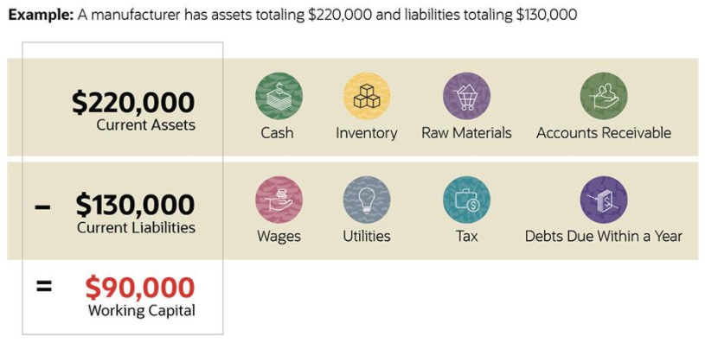
Working Capital Requirement
PROJECT MANAGEMENT
Notes:
A project is a unique endeavor to produce a set of deliverables within clearly specified time, cost and quality constraints. Projects are different from standard business operational activities as they:
• Are unique in nature. They do not involve repetitive processes. Every project undertaken is different from the last, whereas operational activities often involve undertaking repetitive (identical) processes.
• Have a defined timescale. Projects have a clearly specified start and end date within which the deliverables must be produced to meet a specified customer requirement.
• Have an approved budget. Projects are allocated a level of financial expenditure within which the deliverables are produced, to meet a specified customer requirement.
• Have limited resources. At the start of a project an agreed amount of labor, equipment and materials is allocated to the project.
• Involve an element of risk. Projects entail a level of uncertainty and therefore carry business risk.
• Achieve beneficial change. The purpose of a project is typically to improve an organization through the implementation of business change.

Slide 26
Prepare Projected Balance Sheet
Following steps will be helpful for preparing projected balance sheet.
Calculate cash in hand and cash at bank
Calculate Fixed Assets
Calculate Value of Financial Instruments
Calculate your Business Earning
Calculate Business's Liabilities
Calculate Business's Capital
PROJECT MANAGEMENT
Notes:
A project is a unique endeavor to produce a set of deliverables within clearly specified time, cost and quality constraints. Projects are different from standard business operational activities as they:
• Are unique in nature. They do not involve repetitive processes. Every project undertaken is different from the last, whereas operational activities often involve undertaking repetitive (identical) processes.
• Have a defined timescale. Projects have a clearly specified start and end date within which the deliverables must be produced to meet a specified customer requirement.
• Have an approved budget. Projects are allocated a level of financial expenditure within which the deliverables are produced, to meet a specified customer requirement.
• Have limited resources. At the start of a project an agreed amount of labor, equipment and materials is allocated to the project.
• Involve an element of risk. Projects entail a level of uncertainty and therefore carry business risk.
• Achieve beneficial change. The purpose of a project is typically to improve an organization through the implementation of business change.

Slide 27
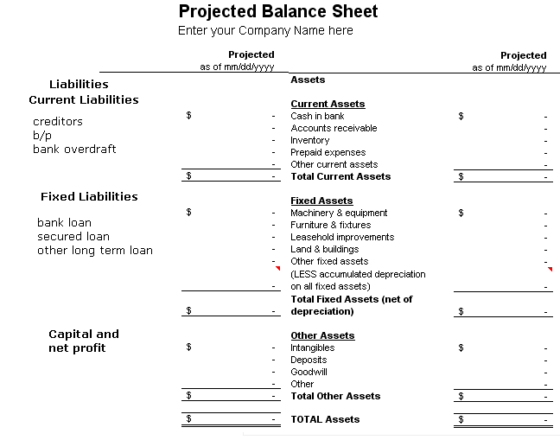
Prepare Projected balance Sheet
PROJECT MANAGEMENT
Notes:
A project is a unique endeavor to produce a set of deliverables within clearly specified time, cost and quality constraints. Projects are different from standard business operational activities as they:
• Are unique in nature. They do not involve repetitive processes. Every project undertaken is different from the last, whereas operational activities often involve undertaking repetitive (identical) processes.
• Have a defined timescale. Projects have a clearly specified start and end date within which the deliverables must be produced to meet a specified customer requirement.
• Have an approved budget. Projects are allocated a level of financial expenditure within which the deliverables are produced, to meet a specified customer requirement.
• Have limited resources. At the start of a project an agreed amount of labor, equipment and materials is allocated to the project.
• Involve an element of risk. Projects entail a level of uncertainty and therefore carry business risk.
• Achieve beneficial change. The purpose of a project is typically to improve an organization through the implementation of business change.

Slide 28
Prepare Income Statement
The income statement is found as follows:
Sales revenue
Less cost of goods sold
Gross profit
Less SG&A
EBITDA
Less Depreciation Expense
EBIT or Operating Income
Less Interest Expense
EBT
Less Tax Expense
Net Income
PROJECT MANAGEMENT
Notes:
A project is a unique endeavor to produce a set of deliverables within clearly specified time, cost and quality constraints. Projects are different from standard business operational activities as they:
• Are unique in nature. They do not involve repetitive processes. Every project undertaken is different from the last, whereas operational activities often involve undertaking repetitive (identical) processes.
• Have a defined timescale. Projects have a clearly specified start and end date within which the deliverables must be produced to meet a specified customer requirement.
• Have an approved budget. Projects are allocated a level of financial expenditure within which the deliverables are produced, to meet a specified customer requirement.
• Have limited resources. At the start of a project an agreed amount of labor, equipment and materials is allocated to the project.
• Involve an element of risk. Projects entail a level of uncertainty and therefore carry business risk.
• Achieve beneficial change. The purpose of a project is typically to improve an organization through the implementation of business change.

Slide 29
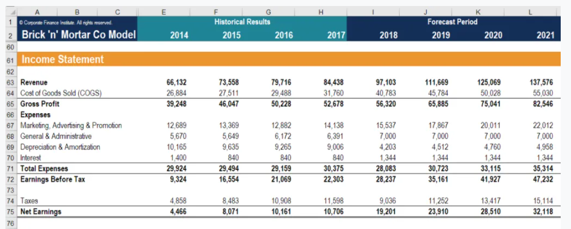
Prepare Income Statement
PROJECT MANAGEMENT
Notes:
A project is a unique endeavor to produce a set of deliverables within clearly specified time, cost and quality constraints. Projects are different from standard business operational activities as they:
• Are unique in nature. They do not involve repetitive processes. Every project undertaken is different from the last, whereas operational activities often involve undertaking repetitive (identical) processes.
• Have a defined timescale. Projects have a clearly specified start and end date within which the deliverables must be produced to meet a specified customer requirement.
• Have an approved budget. Projects are allocated a level of financial expenditure within which the deliverables are produced, to meet a specified customer requirement.
• Have limited resources. At the start of a project an agreed amount of labor, equipment and materials is allocated to the project.
• Involve an element of risk. Projects entail a level of uncertainty and therefore carry business risk.
• Achieve beneficial change. The purpose of a project is typically to improve an organization through the implementation of business change.

Slide 30
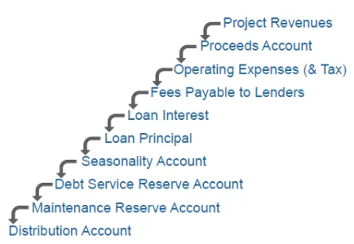
Cash Flow Statement
The cashflow waterfall is negotiated between the borrower (the SPV) and the lender and is stated in the loan agreement. Below is a hypothetical cashflow waterfall which you might see in the market. They vary, but here is one!
PROJECT MANAGEMENT
Notes:
A project is a unique endeavor to produce a set of deliverables within clearly specified time, cost and quality constraints. Projects are different from standard business operational activities as they:
• Are unique in nature. They do not involve repetitive processes. Every project undertaken is different from the last, whereas operational activities often involve undertaking repetitive (identical) processes.
• Have a defined timescale. Projects have a clearly specified start and end date within which the deliverables must be produced to meet a specified customer requirement.
• Have an approved budget. Projects are allocated a level of financial expenditure within which the deliverables are produced, to meet a specified customer requirement.
• Have limited resources. At the start of a project an agreed amount of labor, equipment and materials is allocated to the project.
• Involve an element of risk. Projects entail a level of uncertainty and therefore carry business risk.
• Achieve beneficial change. The purpose of a project is typically to improve an organization through the implementation of business change.

Slide 31
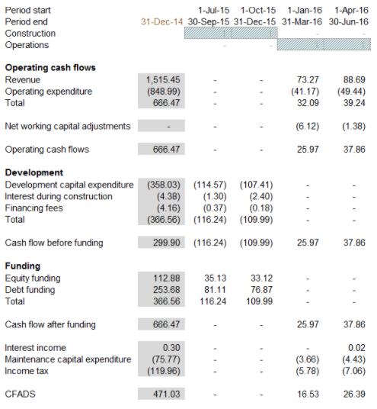
Cash Flow Statement
PROJECT MANAGEMENT
Notes:
A project is a unique endeavor to produce a set of deliverables within clearly specified time, cost and quality constraints. Projects are different from standard business operational activities as they:
• Are unique in nature. They do not involve repetitive processes. Every project undertaken is different from the last, whereas operational activities often involve undertaking repetitive (identical) processes.
• Have a defined timescale. Projects have a clearly specified start and end date within which the deliverables must be produced to meet a specified customer requirement.
• Have an approved budget. Projects are allocated a level of financial expenditure within which the deliverables are produced, to meet a specified customer requirement.
• Have limited resources. At the start of a project an agreed amount of labor, equipment and materials is allocated to the project.
• Involve an element of risk. Projects entail a level of uncertainty and therefore carry business risk.
• Achieve beneficial change. The purpose of a project is typically to improve an organization through the implementation of business change.

Slide 32
Project Identification
PROJECT MANAGEMENT
Notes:
A project is a unique endeavor to produce a set of deliverables within clearly specified time, cost and quality constraints. Projects are different from standard business operational activities as they:
• Are unique in nature. They do not involve repetitive processes. Every project undertaken is different from the last, whereas operational activities often involve undertaking repetitive (identical) processes.
• Have a defined timescale. Projects have a clearly specified start and end date within which the deliverables must be produced to meet a specified customer requirement.
• Have an approved budget. Projects are allocated a level of financial expenditure within which the deliverables are produced, to meet a specified customer requirement.
• Have limited resources. At the start of a project an agreed amount of labor, equipment and materials is allocated to the project.
• Involve an element of risk. Projects entail a level of uncertainty and therefore carry business risk.
• Achieve beneficial change. The purpose of a project is typically to improve an organization through the implementation of business change.

Slide 33
Project Identification
Collection, compilation and analysis of data to locate potential opportunities for starting business and development of such opportunities
Opportunity is a business concept, which if turned into a tangible product or service, by the enterprise, will result into profit. It is all about creating values
The search of a good idea:
  Generate your own idea
  Develop someone else’s idea
PROJECT MANAGEMENT

Slide 34
Importance of Project Identification
It has long term consequences (make or break)
Involves commitment which can not be easily reversed
Ideas are put into action
Projects are catalytic agents for economic development
Involves creative use of resources- manpower, capital, raw materials etc.
Generates value addition and build-up national capital
Brings socio-cultural development
Leads to development of infra-structure and environment
PROJECT MANAGEMENT

Slide 35
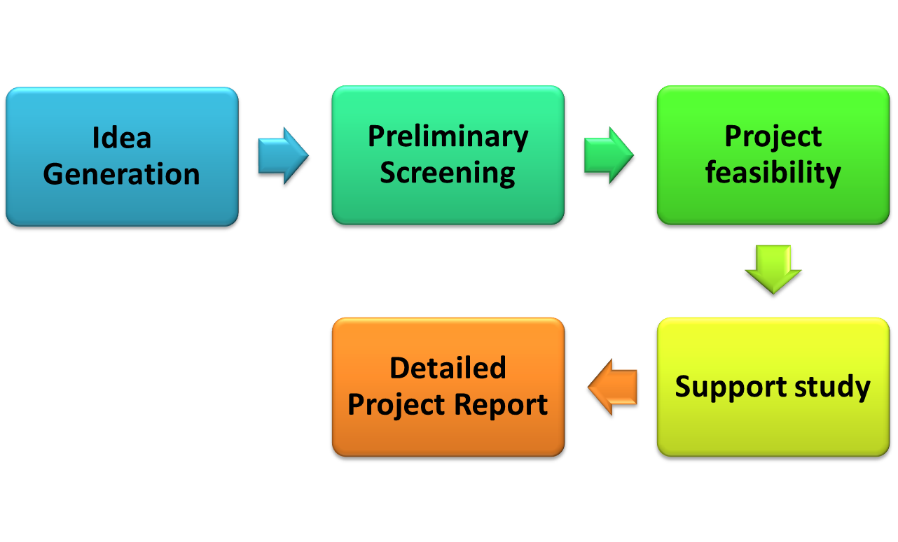
Steps in Project Identification
PROJECT MANAGEMENT
Notes:
A project is a unique endeavor to produce a set of deliverables within clearly specified time, cost and quality constraints. Projects are different from standard business operational activities as they:
• Are unique in nature. They do not involve repetitive processes. Every project undertaken is different from the last, whereas operational activities often involve undertaking repetitive (identical) processes.
• Have a defined timescale. Projects have a clearly specified start and end date within which the deliverables must be produced to meet a specified customer requirement.
• Have an approved budget. Projects are allocated a level of financial expenditure within which the deliverables are produced, to meet a specified customer requirement.
• Have limited resources. At the start of a project an agreed amount of labor, equipment and materials is allocated to the project.
• Involve an element of risk. Projects entail a level of uncertainty and therefore carry business risk.
• Achieve beneficial change. The purpose of a project is typically to improve an organization through the implementation of business change.

Slide 36

Project Identification
Idea Generation or Investment Opportunities
Idea generation is the process of grouping logical thoughts based on some factors.
Importance:
Launch of new business / product
Continuous growth of Organization
Survival in the competitive Market
Development of Society
PROJECT MANAGEMENT

Slide 37

Project Identification
Source of Idea Generation
Performance of existing Industry
Examining the inputs and Outputs of various Industry
Review Trade (Local and International)
Availability of Material and Labour at Low cost
Price Trend
Demand and supply Gap
Government guidelines (legal issues)
Economic and social Trends
Study of New Technology and Developments
PROJECT MANAGEMENT

Slide 38



Project Identification
Pre-Feasibility Study / Preliminary Screening
A series of steps to know whether or not a complete detailed feasibility study should be made.
Preliminary screening is done with a view to avoid unnecessary cost and efforts in detailed study.
Collection of data without spending much money and time:
Interview with Government Officials
Interview with Beneficiaries (customers)
Libraries and other sources of data collection
PROJECT MANAGEMENT

Slide 39

Project Identification
Error in Pre-Feasibility Study
Drop Error:
When a good idea is rejected (Loss of Profit)
Go Error:
When a bad idea is selected (heavy loss)
PROJECT MANAGEMENT

Slide 40
Preliminary Screening Project rating Index Method
PROJECT SCORE SHEET (UNWEIGHTED)
SECTION I - BASIS OF PROJECT DECISION
 | Definition Level (Rating) |  |  |  |  |  |  | Weight | Factor Score
CATEGORY Element | 0 | 1 | 2 | 3 | 4 | 5 | Score | (out of 1) | Weight X Rating
A. BUSINESS STRATEGY
A1. Building Use
A2. Business Justification
A3. Business Plan
A4. Economic Analysis
A5. Facility Requirements
A6. Future Expansion/Alteration Considerations
A7. Site Selection Considerations
A8. Project Objectives Statement
B. OWNER PHILOSOPHIES
B1. Reliability Philosophy
B2. Maintenance Philosophy
B3. Operating Philosophy
B4. Design Philosophy
C. PROJECT REQUIREMENTS
C1. Value-Analysis Process
C2. Project Design Criteria
C3. Evaluation of Existing Facilities
C4. Scope of Work Overview
C5. Project Schedule
C6. Project Cost Estimate
Definition Levels
0 = Not Applicable, 1 = Complete Definition, 2 = Minor Deficiencies, 3 = Some Deficiencies , 4 = Major Deficiencies, 5 = Incomplete or Poor Definition
PROJECT MANAGEMENT

Slide 41

Steps in Project rating Index Method
Identify relevant factors (Useful to the project).
Assign weight to each factor on the basis of importance.
Rate each factors on the rating scale
Multiply the factor rating with factor weight (get factor score)
Make a sum of weighted factor score (get rating index)
Reject if value is less than desired value
Accept if value is more than desired value
PROJECT MANAGEMENT

Slide 42

Feasibility Study / Detailed Feasibility study
To identify the selection or rejection of the project by spending money and time on the basis of primary data in formal way.
Objectives:
It guarantees the success of the project
It works as basic ‘Terms of reference’
Describes nature and complexity
Gives an idea about investment in project
Idea of risk involved
Idea about economic and social benefits
PROJECT MANAGEMENT

Slide 43
Components of Detailed Feasibility study
Market and Demand Analysis
Technical Analysis
Financial Analysis
Social cost-benefit Analysis
Environmental and other Risk analysis
PROJECT MANAGEMENT

Slide 44

Support Study / Functional Study
An in depth investigation into any one or a couple of critical aspects of a project, to help the feasibility study
It may be done:
Before Pre-feasibility Study
Before feasibility Study
After Pre-feasibility Study
After feasibility Study
Example: Launching of new cola in a market with a critical factor pricing.
A support study is required to study specifically price of other competitive products and cost of self
PROJECT MANAGEMENT

Slide 45
Pre- Feasibility Study Vs Feasibility study
Factors | Pre-Feasibility Study | Feasibility Study
Objective | Whether or not the project idea needs further investigation | To determine the true profitability
Scope | Overview study | Detailed Study
Type of Data | Secondary Data (informal sources) | Mix of Primary and Secondary data ( both formal and informal sources)
Time involved | Low | High
Cost involved | Low | High
Accuracy | Low | High
PROJECT MANAGEMENT

Slide 46
Detailed Project Report (DPR)
A formal written document containing the process of project formulation and briefing the project scope.
PROJECT MANAGEMENT

Slide 47
Detailed Project Report (DPR)
STEPS IN DPR PREPARATION:
Step (i): Selection of project
Step (ii): Resource possession and use
Step (iii) : Survey and Mapping
Step (iv) : Assessment of Deficiencies
Step (v) : Integration of Social Infrastructure
Step (vi) : Establishing Linkages with City-wide infrastructure Network
Step (vii) : Preparation of Detailed Designs after assessment of Demand / Gap
Step (viii) : Statutory approvals
Step (ix) : Estimation of Project Cost
Step (x) : Implementation and Management arrangements
Step (xi): Operation and Maintenance plan of proposed assets..
PROJECT MANAGEMENT

Slide 48
THANKS
END OF UNIT- IV
PROJECT MANAGEMENT

